Slide 1
Iteration
Programming
Data Science and Business Analytics

Slide 2
AUTOMATION
Sometimes we want to execute code repeatedly (for example, calling a function). It is convenient if we can automate this process.
This can be done with:
for loops
while loops
We also sometimes want to check whether certain conditions are met. This can be done with
if and else statements

Slide 3
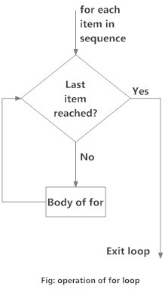
FOR LOOP
A for loop:
Repeats a process a predetermined number of times
Does this by iterating over a given sequence
Stops when the end of the sequence is reached
for i in [0, 1, 2, 3, 4]: print("Current number is:", i)
The ‘i’ is called an iterator variable, which we can use inside the loop body. We can also choose a different name for it.

Slide 4
FOR LOOP
A for loop can work with different sequences.. The range() function is useful for this.
Count from 0 to 5:
for i in range(0, 5):
print("Current number is:", i)
Count down from 5 to 0:
for i in range(5, 0, -1):
print(“Current number is:", i)
Count the number of elements in a list
users = ["John", "Robb", "Bran"] for user in users:
print("Hello", user)

Slide 5
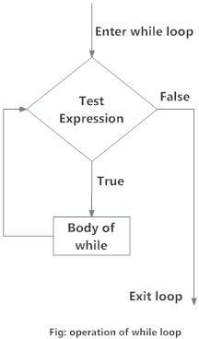
WHILE LOOP
A while loop:
Repeats a process until a given condition is met
(Often used with counters)
counter = 0
maximum = 5
while counter < maximum: print("Counter is:", counter) counter += 1
Shorthand for counter = counter + 1

Slide 6
Exercises
Do Exercise 1

Slide 7
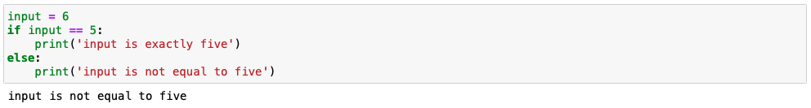
Conditions
The action of a function depends on the input that is given
input == 5 is the condition
print(‘input is exactly five’) is executed if the condition is TRUE
print(‘Input is not equal to five’) is executed if the condition is FALSE
You can do without else { ... }, if nothing should be done if the condition is FALSE

Slide 8
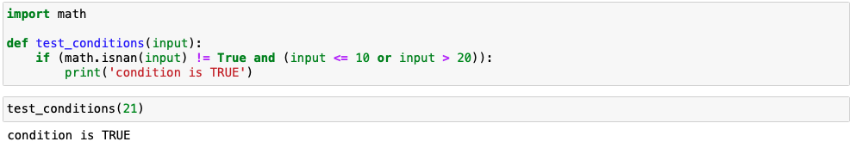
Conditions
You can combine conditions in an if-statement:
! not (TRUE becomes FALSE, FALSE becomes TRUE)
and (both conditions should be TRUE)
or (at least one condition should be TRUE)
( and ) (you sometimes want to combine conditions to change the order of calculation)

Slide 9
Conditions
You can use more than one condition in an if-statement:
if (condition1):
...
elif (condition2):
...
elif (condition3):
...
else:
...

Slide 10
Exercises
Do Exercises 2, 3 and 4

